Slide 1
All About Me
Donovan Walker

Slide 2
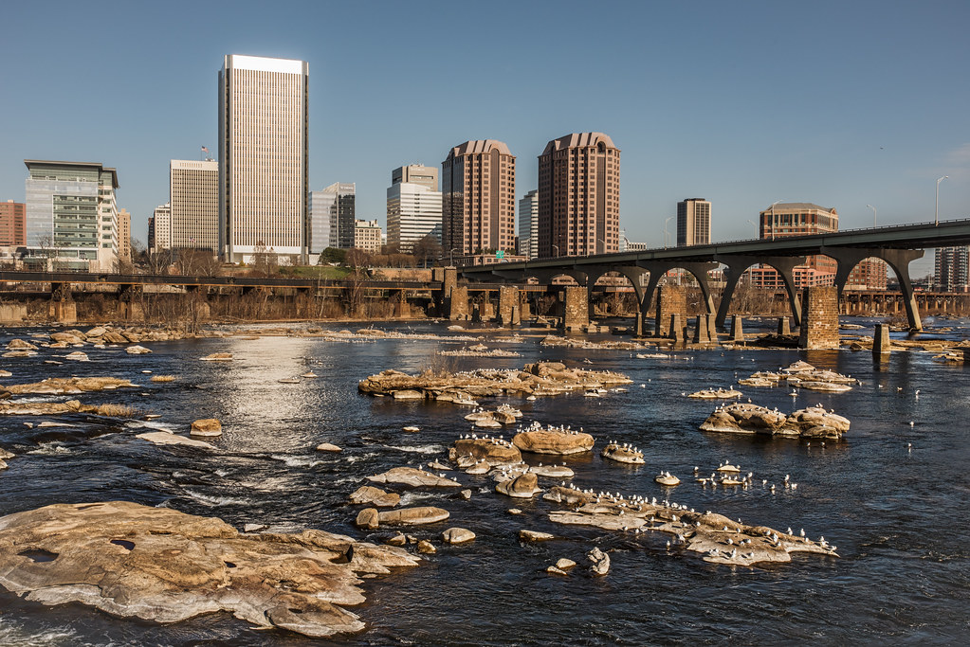

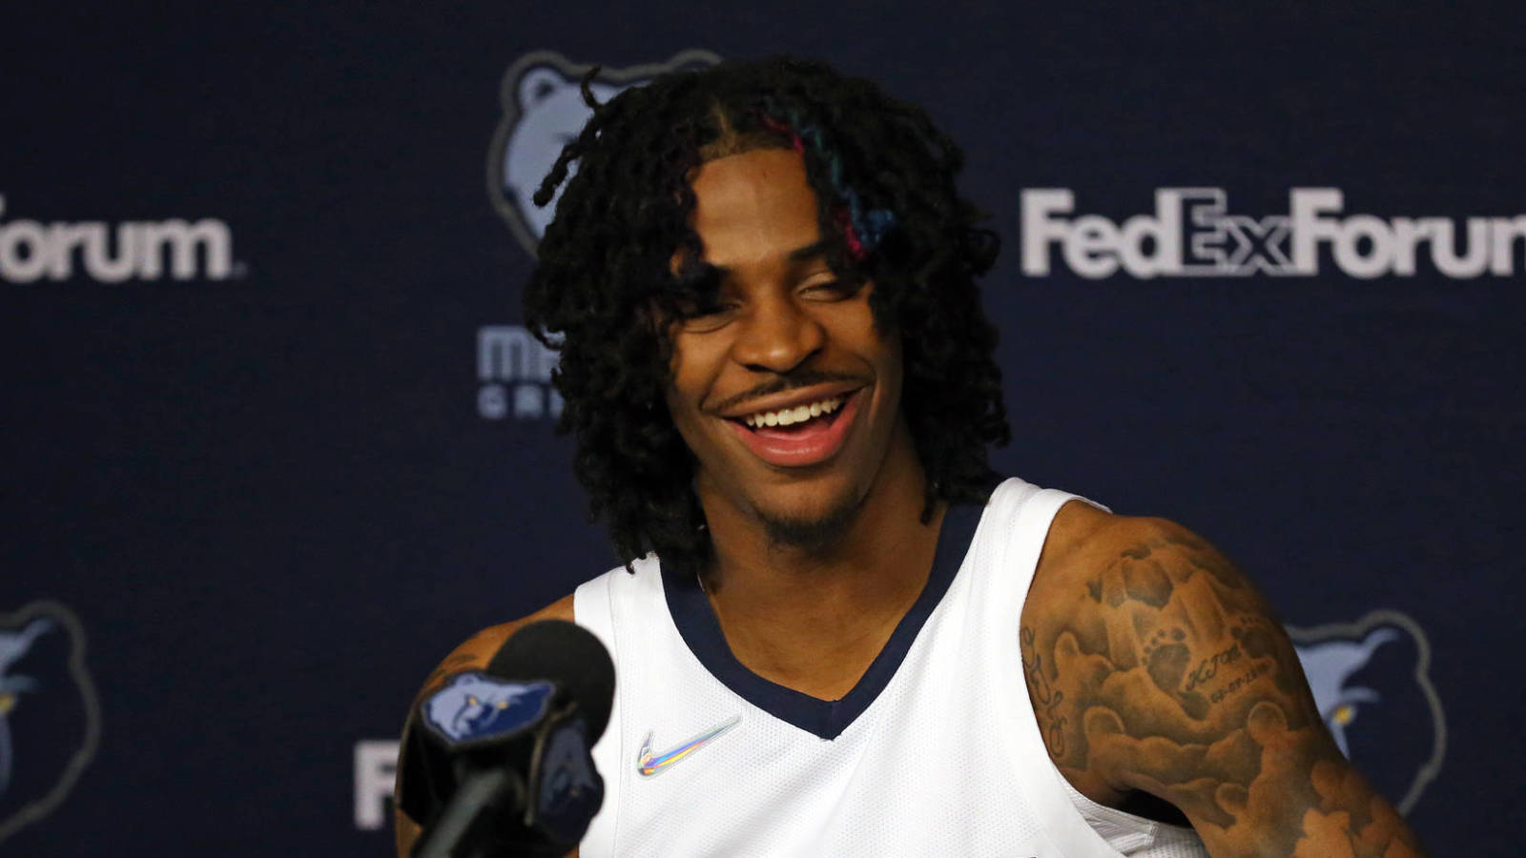
About Me:
My name is Donovan and I am 16 years old. I was born in Richmond, Virginia on August 10th, which means I am a Leo. I share the same birthday with NBA player Ja Morant, as well as reality star Kylie Jenner.

Slide 3
My Family:
I live with three family members, my mom, my aunt and my uncle. Two of them – my mom and uncle – work in jobs that involve helping with others. My aunt worked at VCU up until March of 2022, where she retired.

Slide 4
My Hobbies:
My hobbies consist of watch TV shows or playing games on my PlayStation 4. It helps whenever I am bored at home or I need some form of entertainment.

Slide 5
School Subjects:
This year, my school subjects are in English, Spanish 2, Algebra 2, AP Environmental Science, U.S. History and this Web Development class.

Slide 6
My Personality:
I would describe my personality as a mix of chill with crazy and energetic. When I am chill, I am mostly quiet and relaxed. However, when I am crazy and energetic, I am very hyper. I like it though, because it just shows who I am as a person.

Slide 7
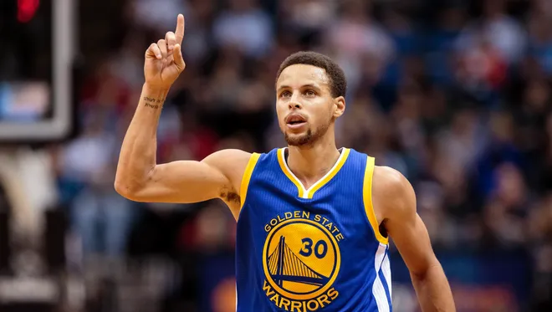
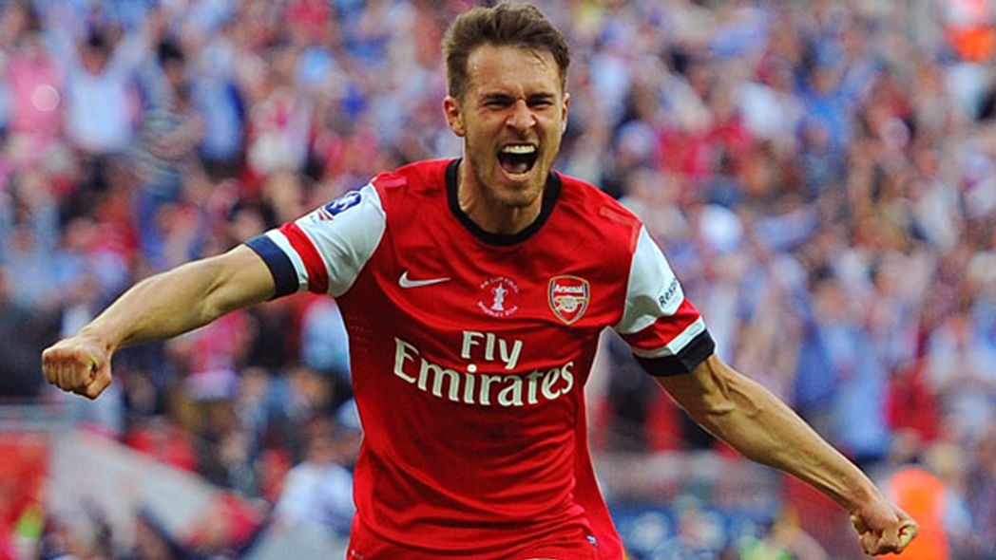
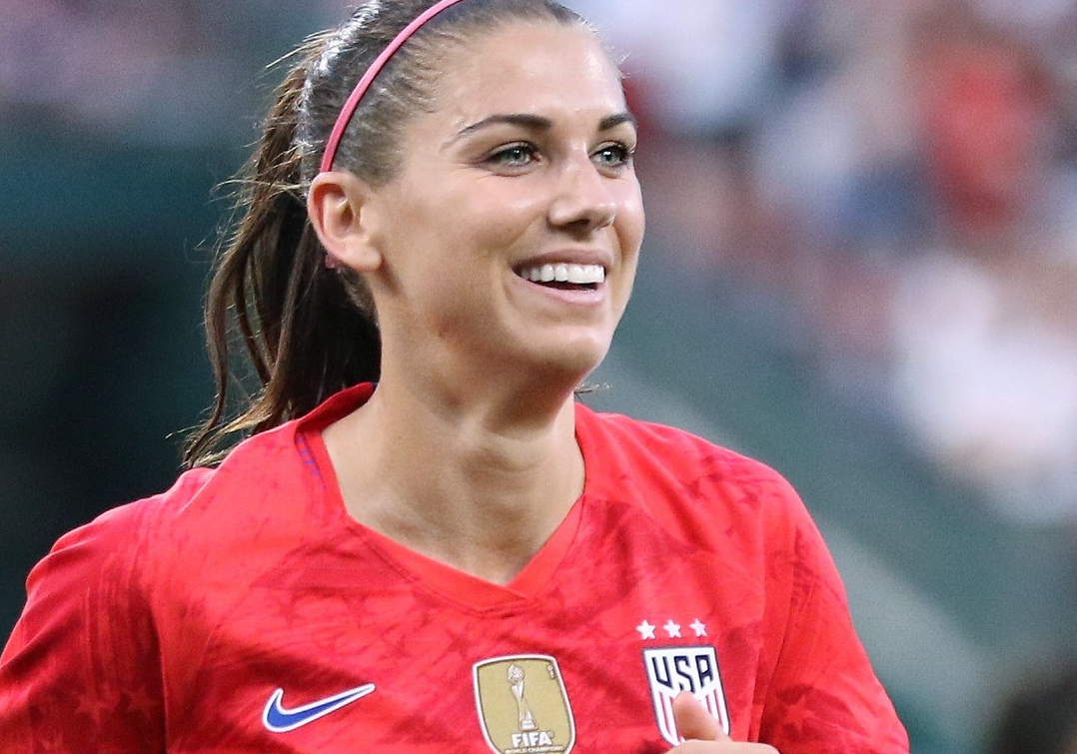
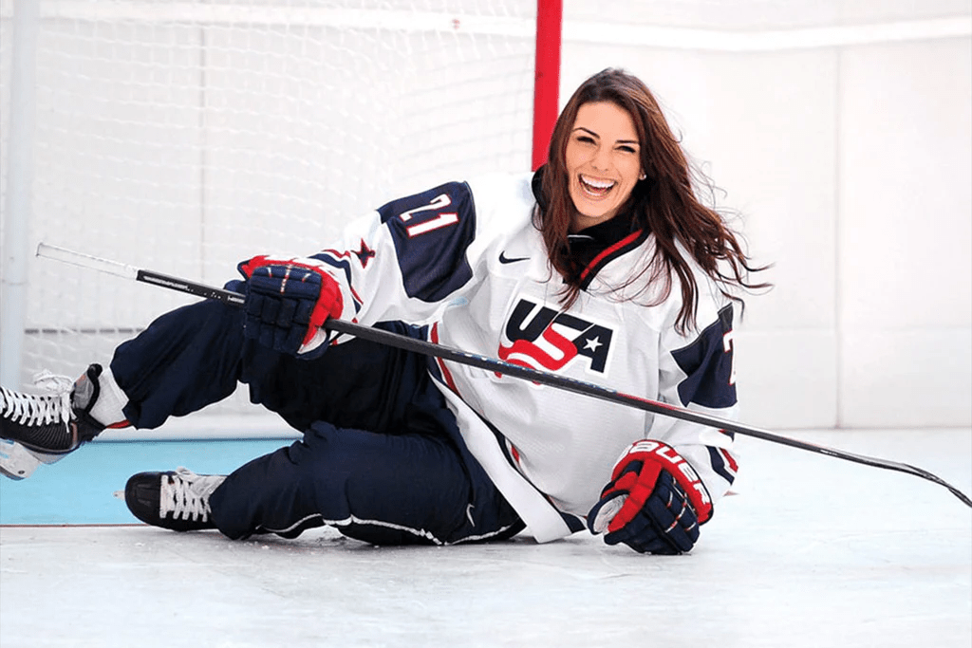
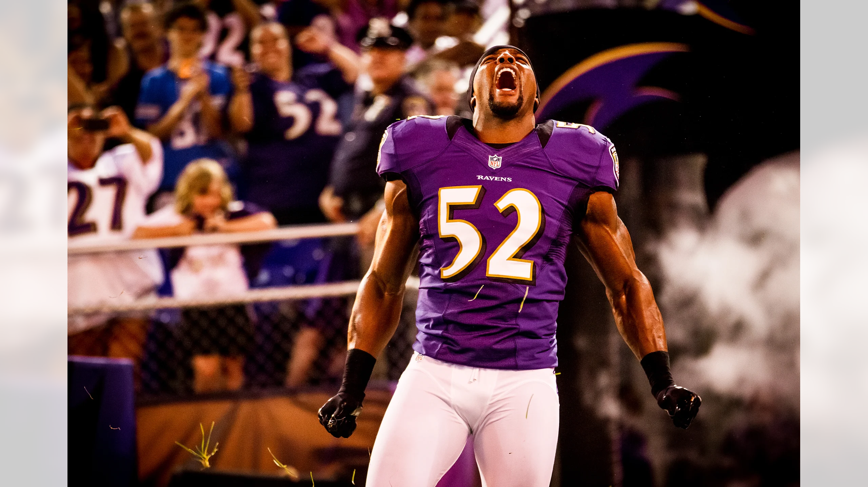
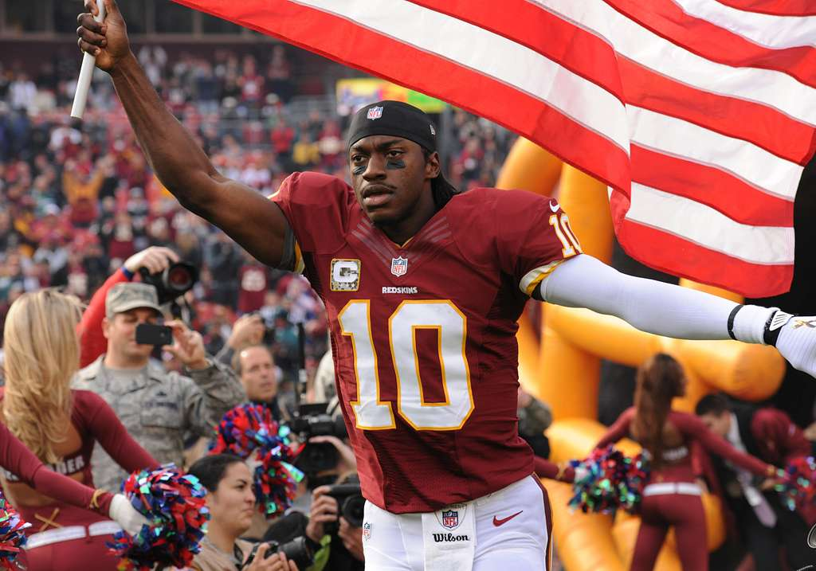
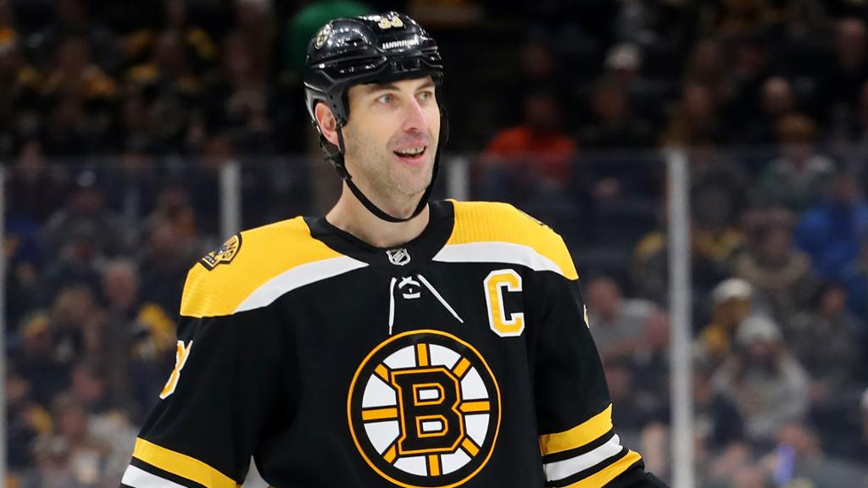
My Role Models:
My role models are Stephen Curry, Aaron Ramsey, Alex Morgan, Hilary Knight, Ray Lewis, Robert Griffin III and Zdeno Chara. They are my role models because anytime I watched a game, they always put in a ton of hard work and I’ve adapted that mindset into both school and my life.

Slide 8
My favorite things to do when I am not at school:
My favorite things to do when I am not at school are playing games on my PlayStation such as Madden and Gran Turismo and watching YouTube videos about sports, cars, or whatever else that I can find.

Slide 9
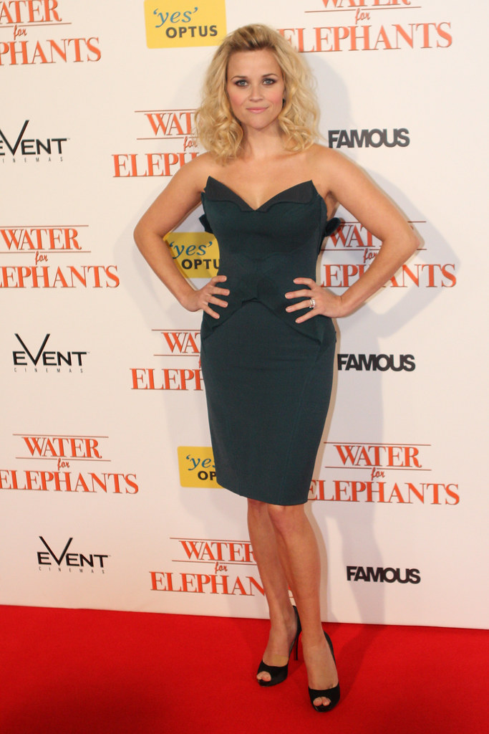
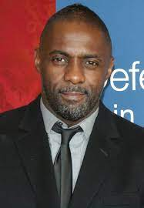
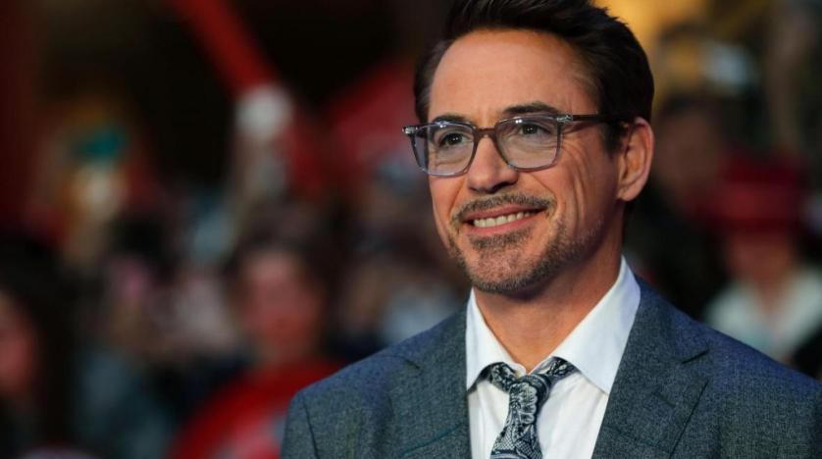
My favorite actors and actresses:
My favorite actors and actresses are Robert Downey Jr, Reese Witherspoon and Idris Elba. To me, they are the best when it comes to their roles in movies and TV shows.

Slide 10
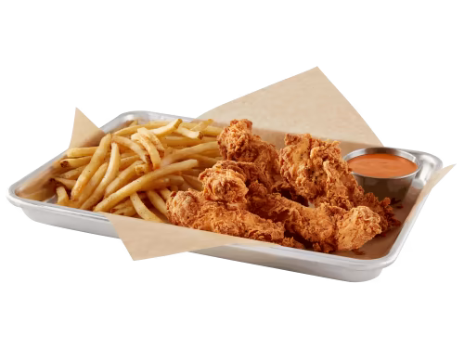
My favorite food:
My favorite food is the fries and chicken tenders from Buffalo Wild Wings. Anytime I go there, I always get it and it is very delicious.

Slide 11
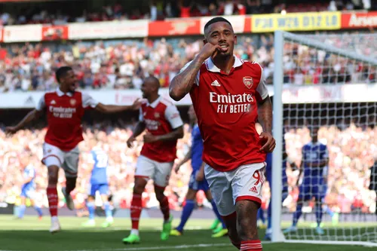
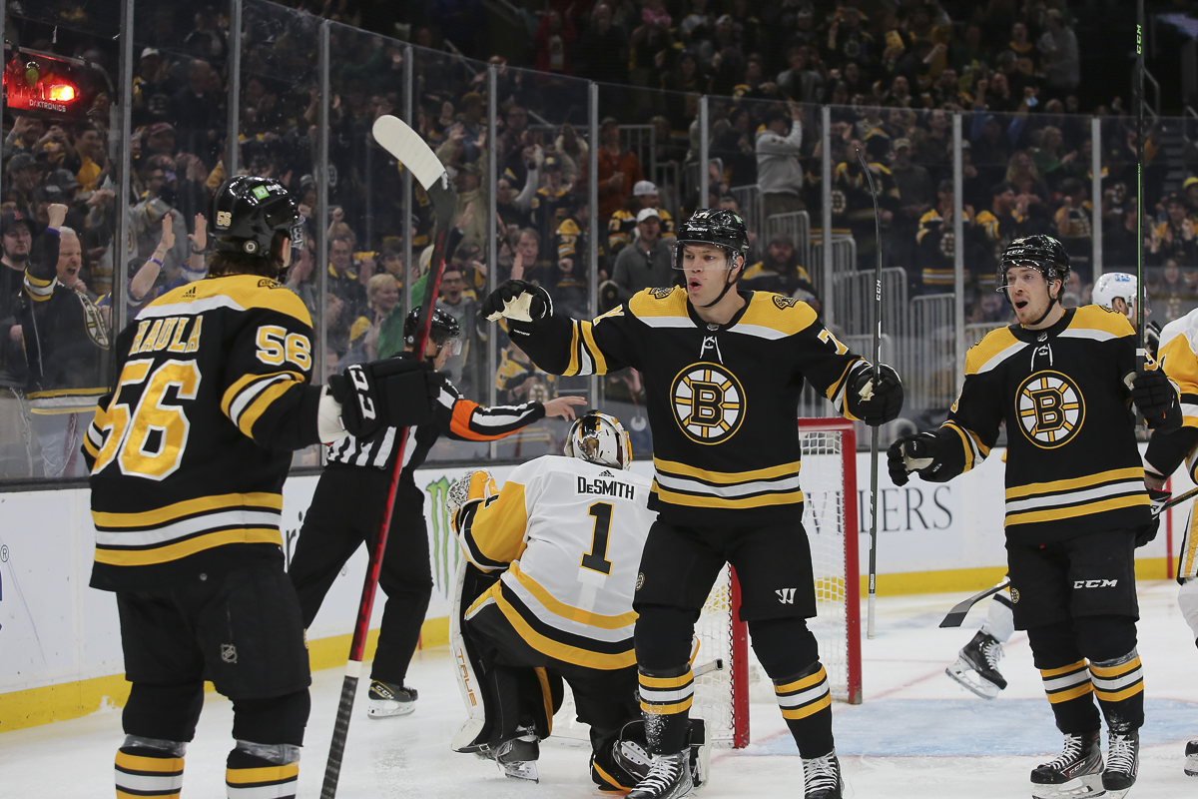
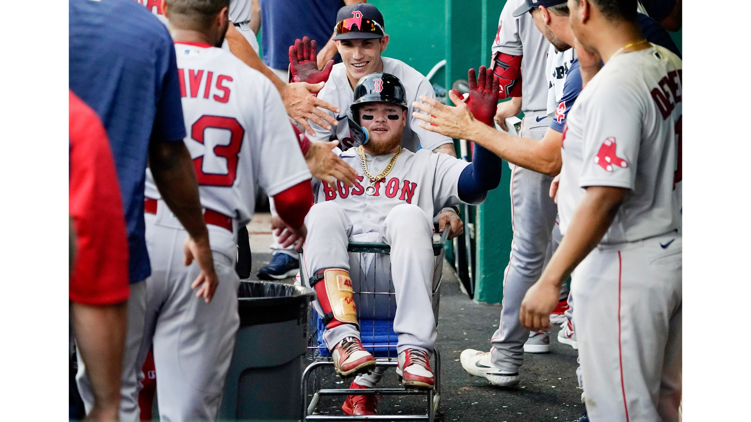
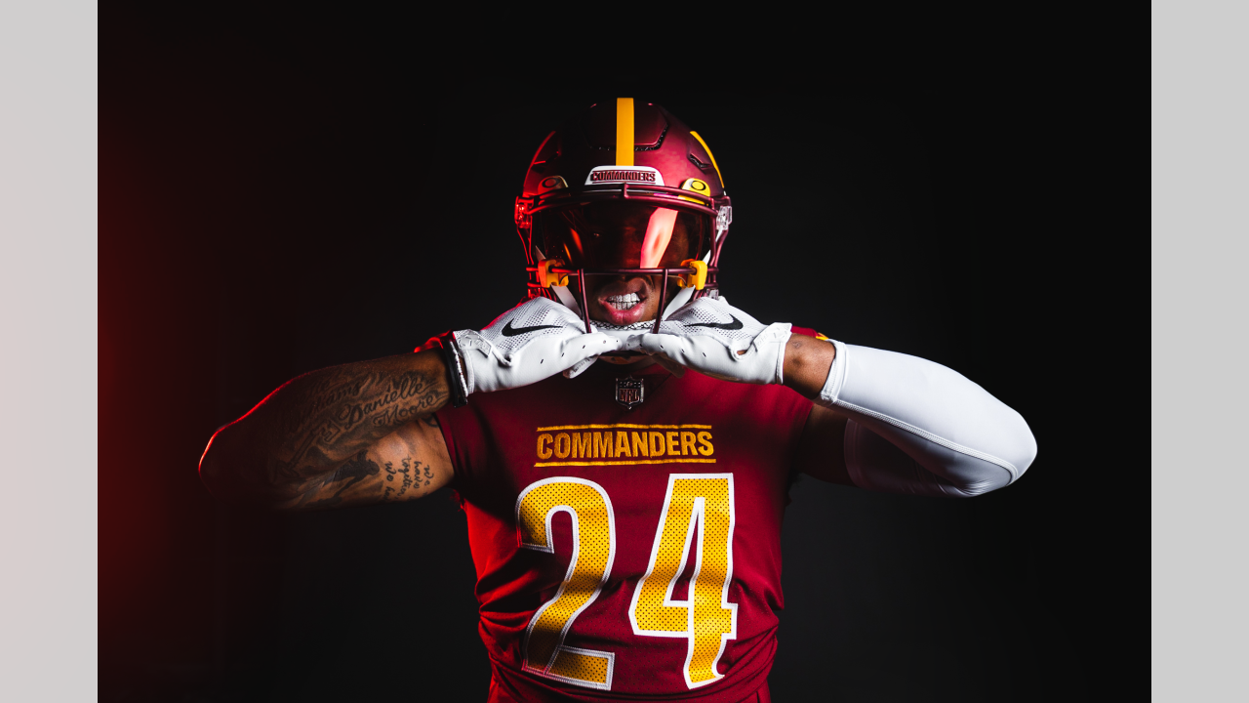
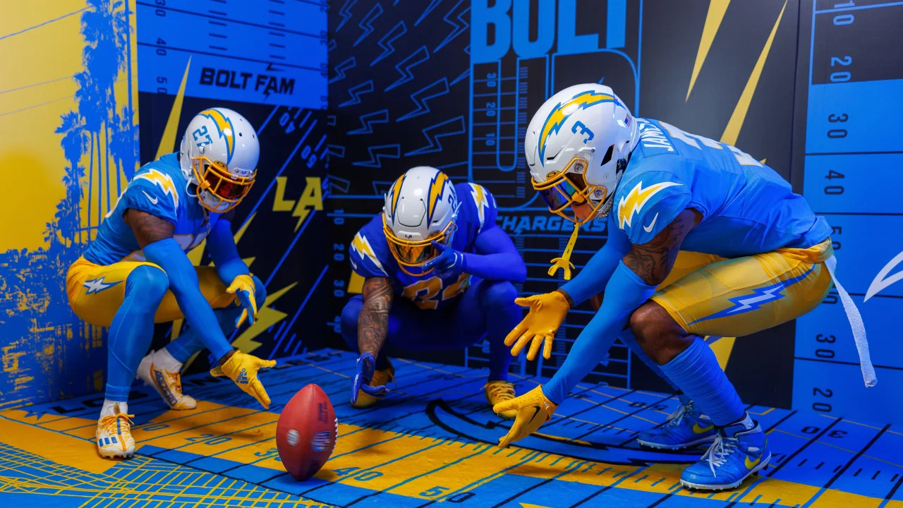
My favorite sports teams:
I have a lot of favorite teams, such as Arsenal FC, the Boston Bruins and Red Sox, the Washington Commanders and Los Angeles Chargers.

Slide 12
Things I like about school:
I like to talk to my friends, especially during lunch. I also like to catch up with some of my old teachers that I had before and see how they are. It shows that I have a lot of conversations with others in school.

Slide 13
Things I don’t like about school:
I don’t like math, it is my least favorite subject. When it comes to math, such as algebra, I am not the best at it. I also do not like how short the transition time is when you get from one class to the other. I think that should be extended a little longer.

Slide 14
Favorite quotes:
“It's always a lot easier when you have people around you supporting you.” – Brad Marchand, winger, Boston Bruins
“I think that our personalities and our souls have so much - we're so much more than just blood vessels and bone and muscle.” – Dale Jr, former NASCAR driver
“No matter the circumstances that you may be going through, just push through it.” – Ray Lewis, former NFL player
“All you need to do to be my friend, is like me.” – Taylor Swift, the best musician to ever exist.

Slide 15
Favorite place to eat:
My favorite place to eat is at Buffalo Wild Wings. I really like how they’re able to have so many TVs with different games on, so you can choose which one you want to watch, while eating good food at the same time. I have been there a few times since 2018 and it is fantastic.

Slide 16
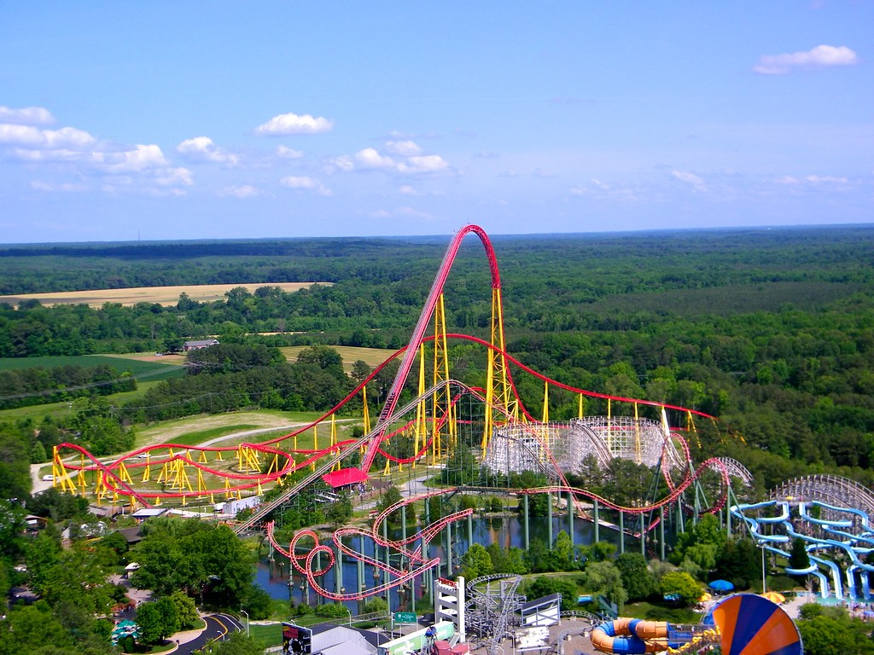
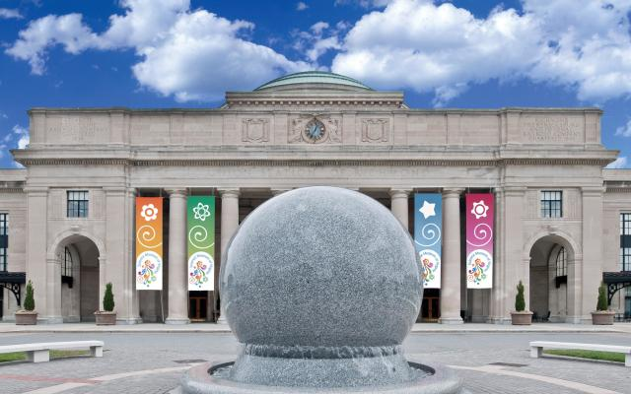
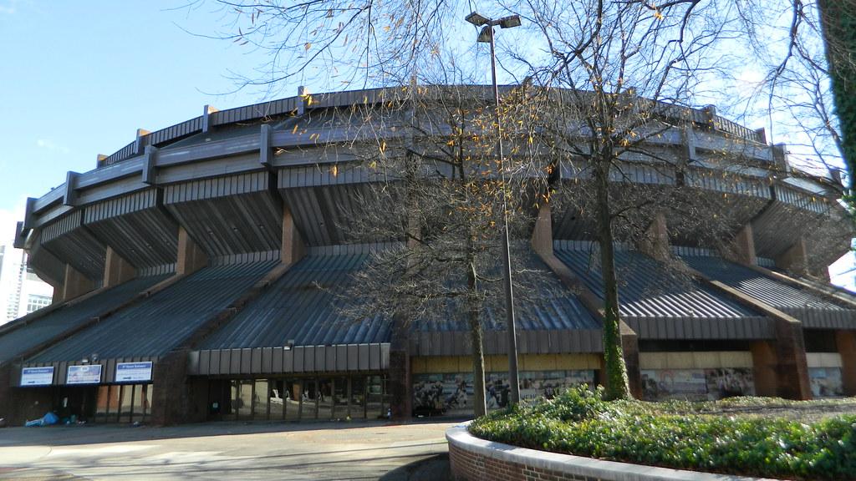
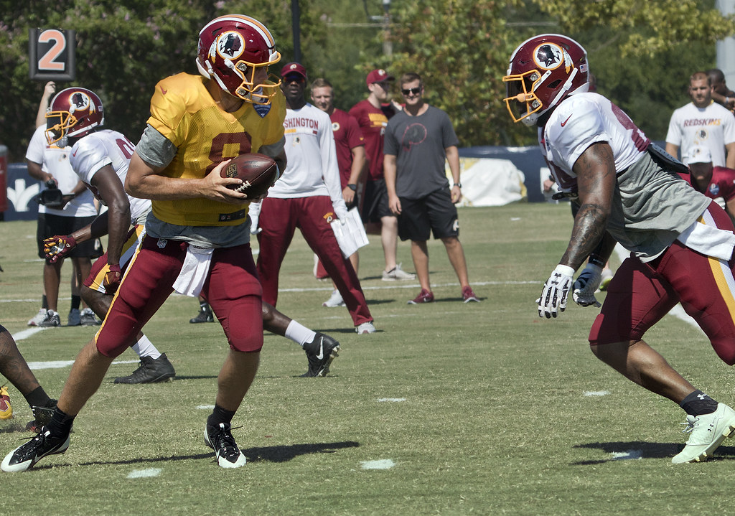
Places I have visited:
I have visited Kings Dominion, the Science Museum of Virginia, the Richmond Coliseum, and the Commanders training camp.

Slide 17
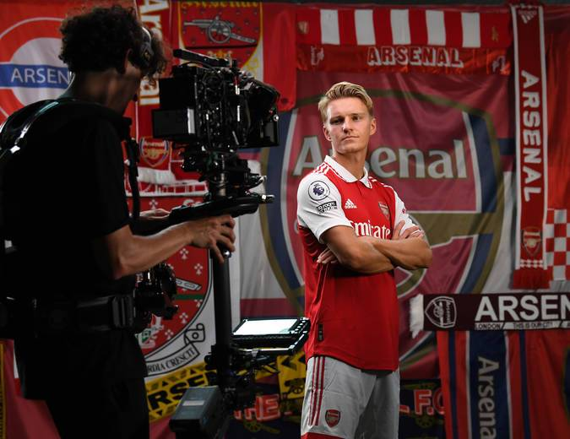
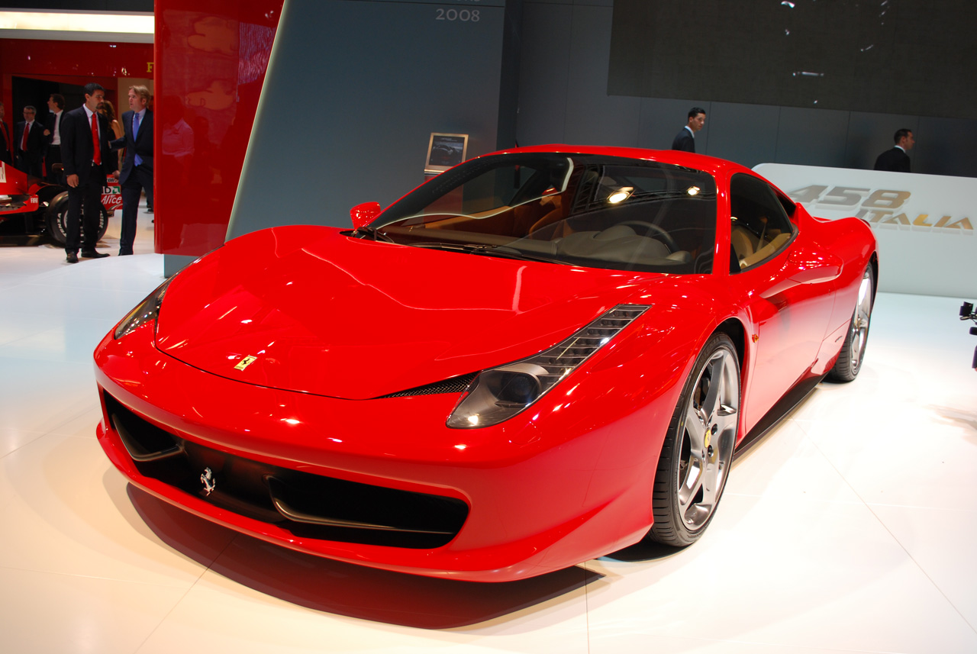
My favorite color:
My favorite color is red. I’ve always liked it because it is bright and it works with things such as one of my dream cars in the Ferrari 458, as well as my favorite football club in Arsenal.

Slide 18
That is all about me!

